Slide 1

Contract Law
Trinity Law School, LA521
Prof. Sharon Kaselonis
skaselonis@tiu.edu

Slide 2
Contract Law Week 1
What is a contract?
Is there a Biblical foundation for contract law?

Slide 3

Colossians 1:16, 17
“For by him were all things created, that are in heaven, and that are in earth, visible and invisible, whether they be thrones, or dominions, or principalities, or powers: all things were created by him, and for him: [17] And he is before all things, and by him all things consist.”
Psalm 119:142
“Thy righteousness is an everlasting righteousness, and thy law is the truth.”
Biblical Application
This Photo by Unknown Author is licensed under CC BY

Slide 4
Biblical Application
Examples of K in Scripture
Terms:
Promise
Covenant
Seal
Adam & Eve in the garden (Gen. 2:17)
Adam & Eve – marriage (Gen. 2)
Jacob & Laban (Gen. 29:16-20)
Abrahamic Covenant (Gen. 17)…
This Photo by Unknown Author is licensed under CC BY

Slide 5
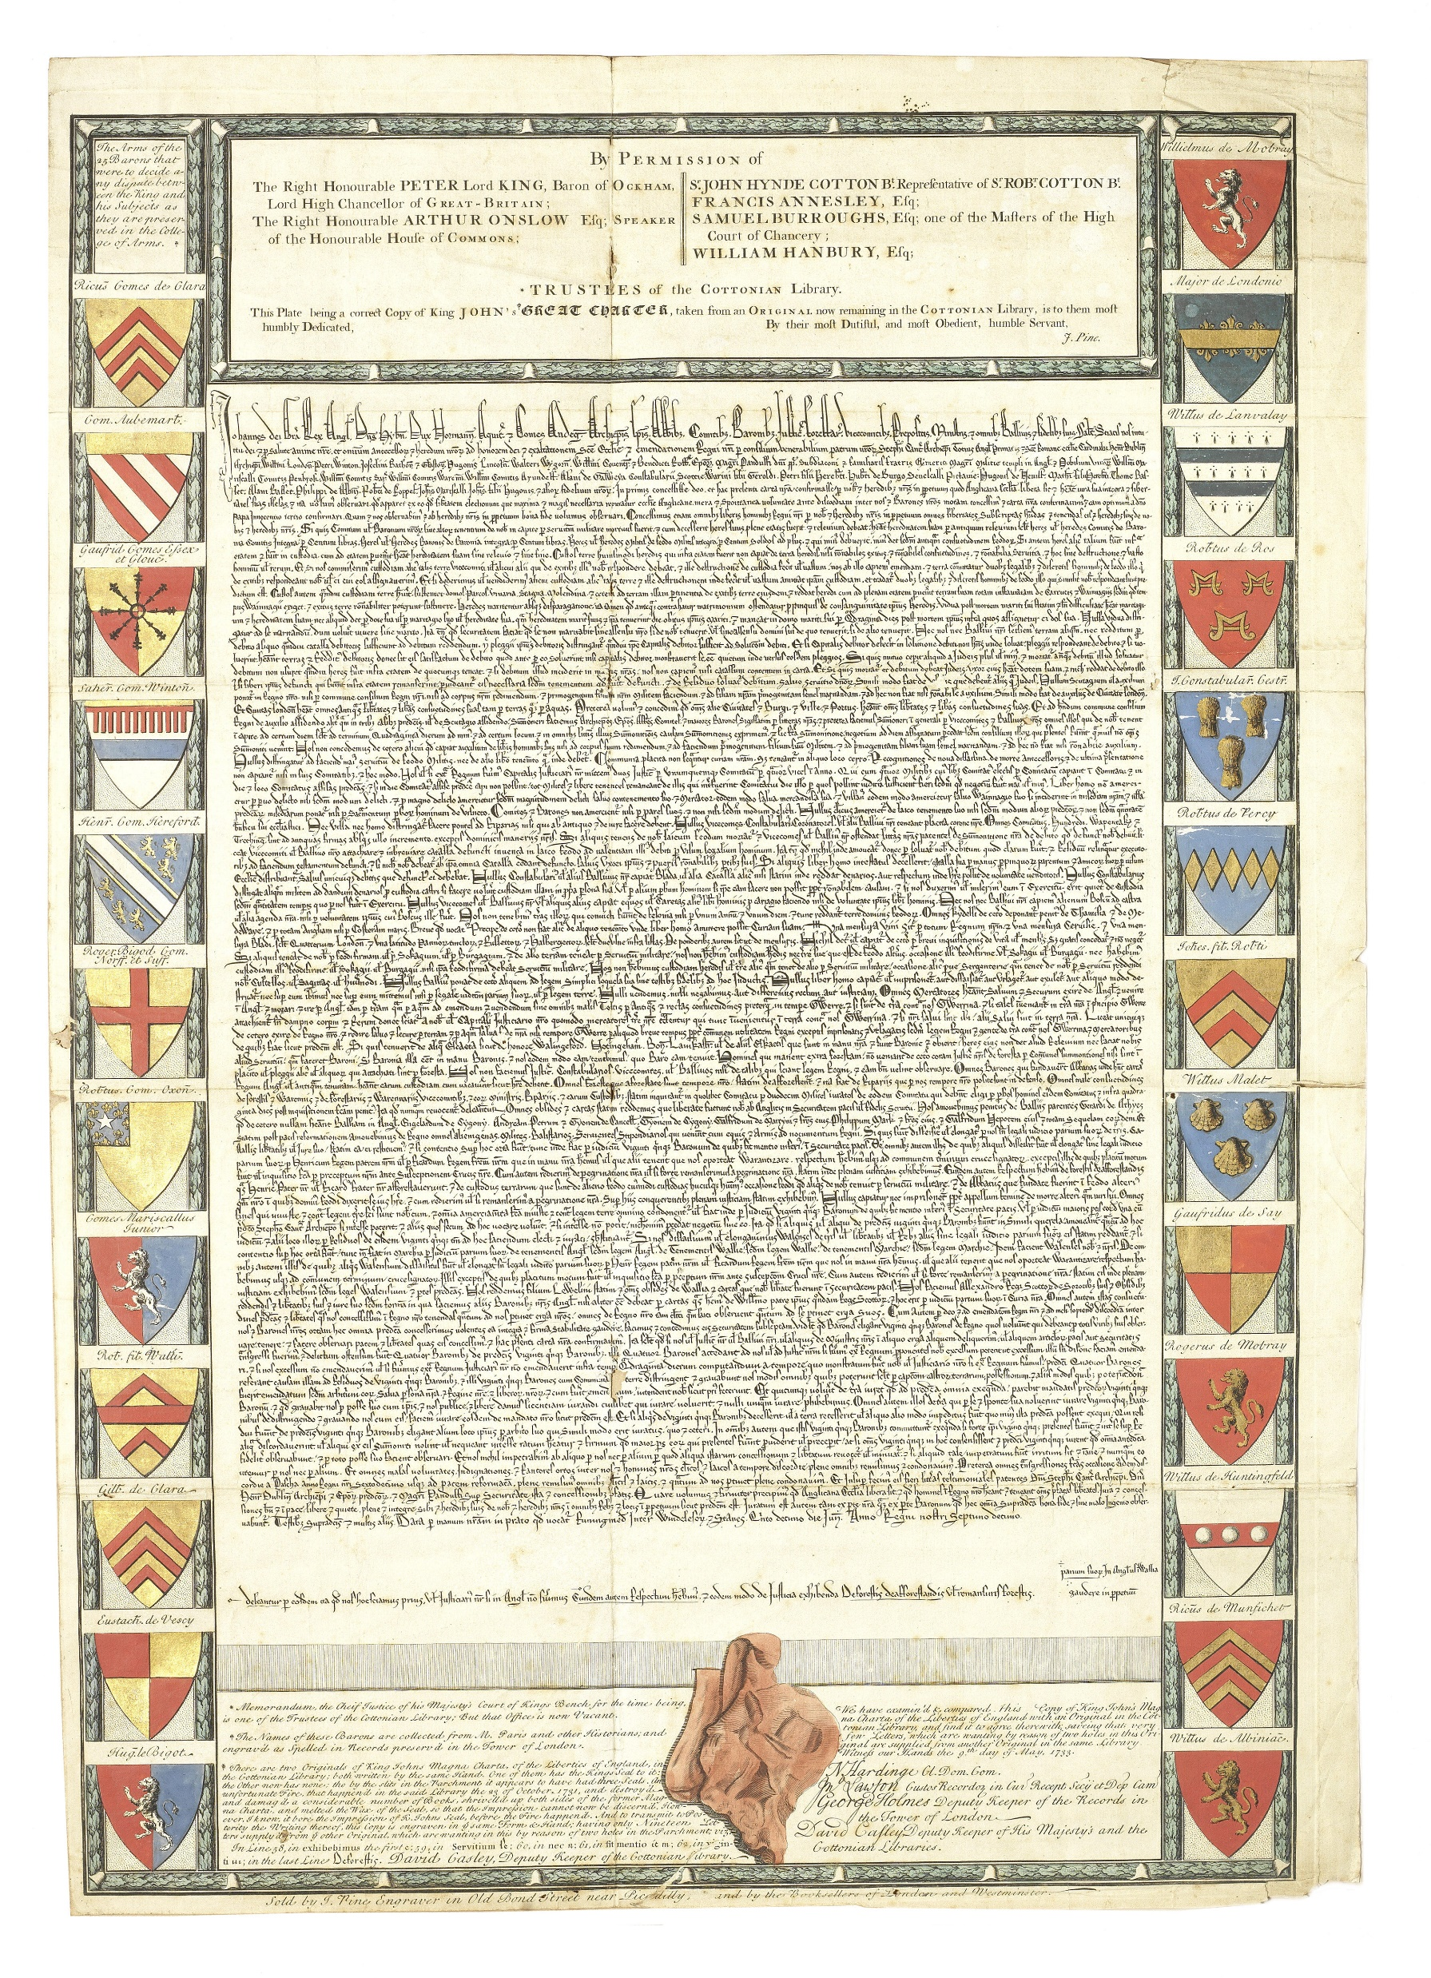
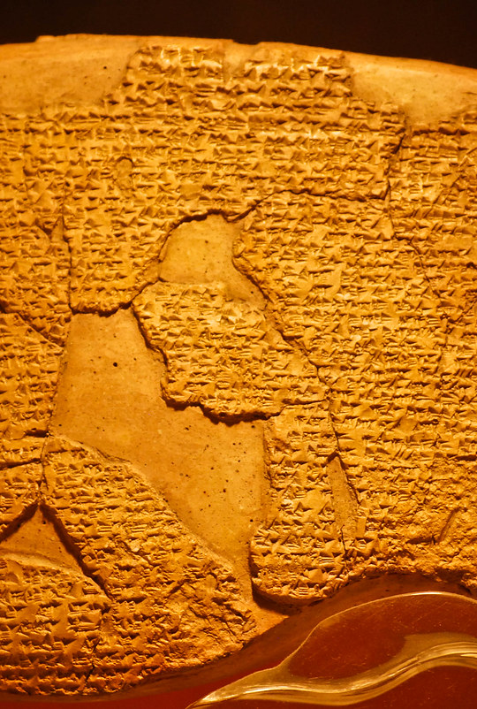
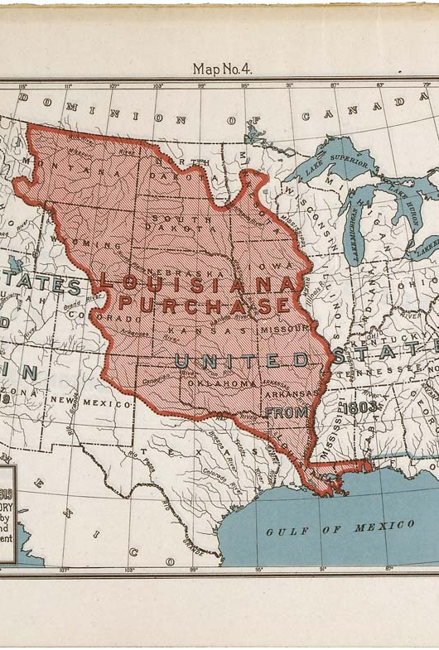
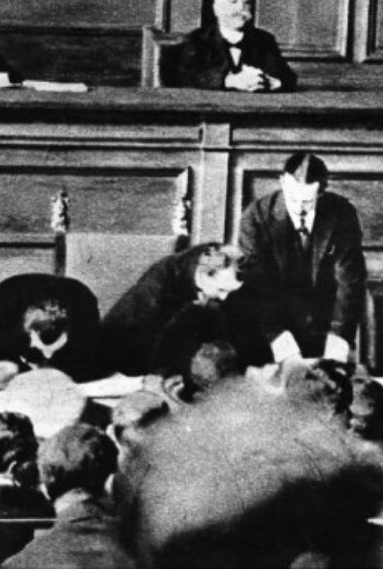
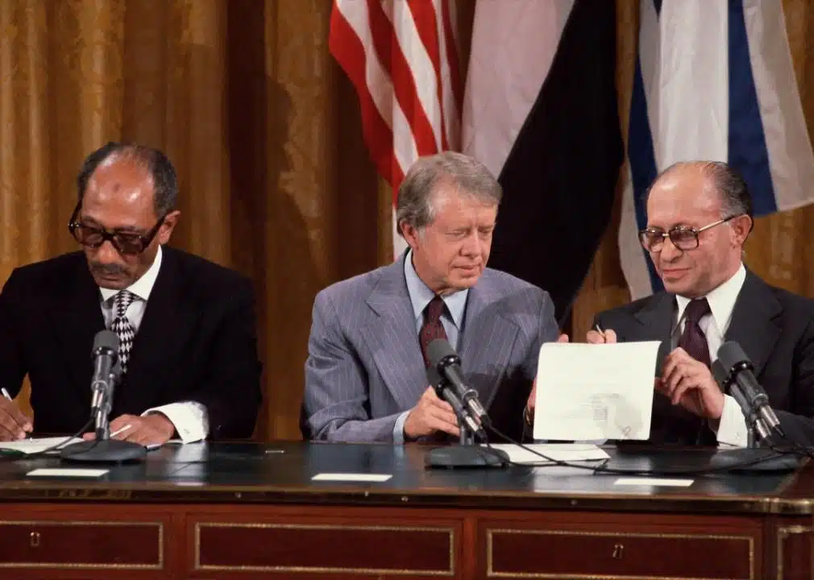
Historical Examples
1259 B.C.
Egyptian–Hittite Peace Treaty
1215
Magna Carta
1803
Louisiana Purchase
1804
Napoleonic Code
1919
Treaty of Versailles / Belfast Agreement
1948
Universal Declaration of Human Rights
This Photo by Unknown Author is licensed under CC BY-SA-NC
This Photo by Unknown Author is licensed under CC BY-SA-NC
This Photo by Unknown Author is licensed under CC BY-SA

Slide 6
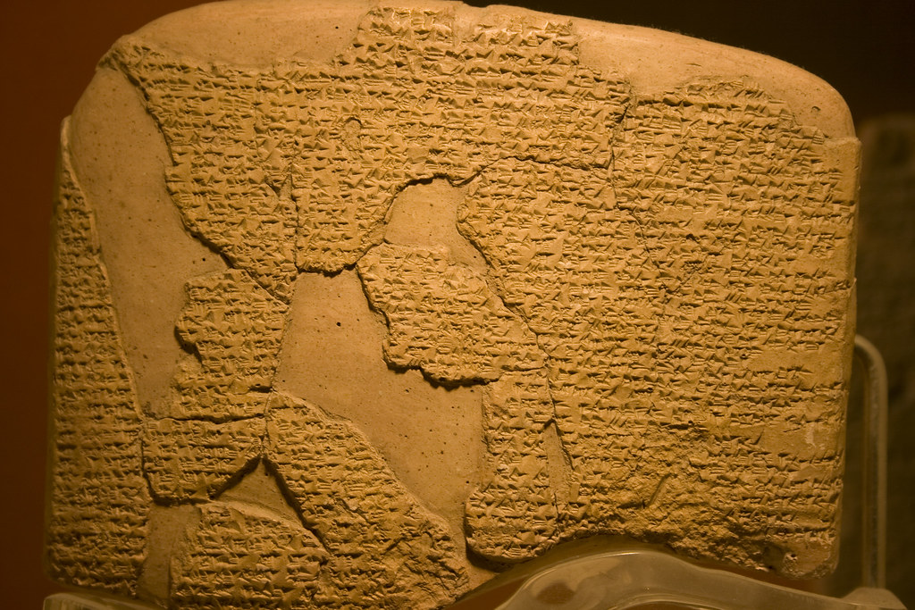
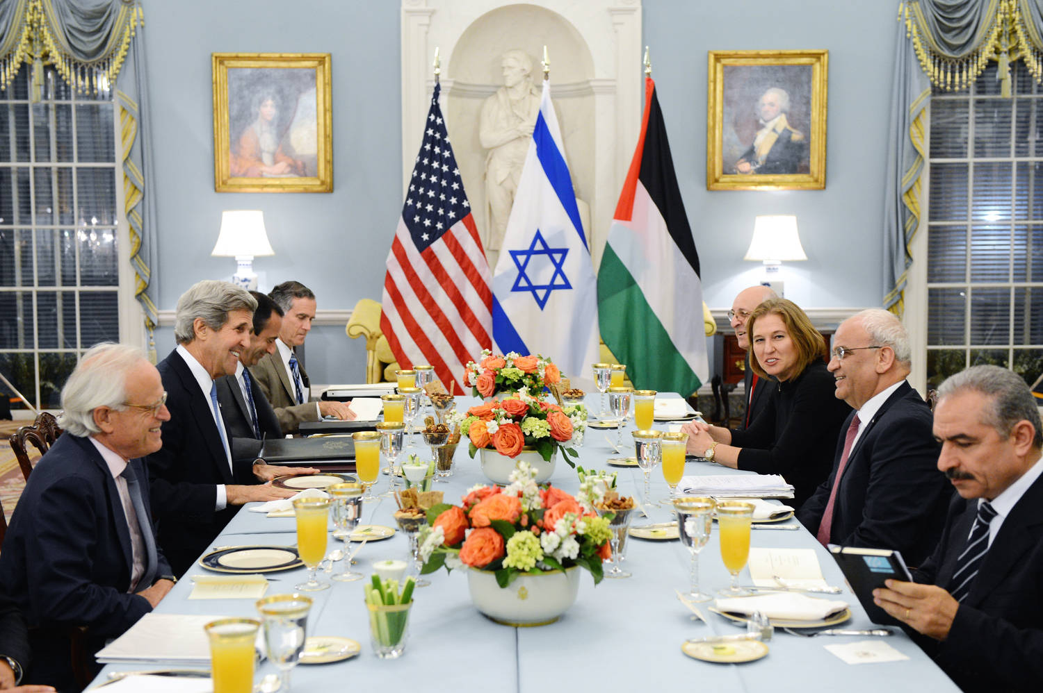
This Photo by Unknown Author is licensed under CC BY-ND

Slide 7
American Contract Law
What is the benefit of K law?
Justice vs Orderly Society
What is the end of K law?
Moral conduct vs Compensation
Should every promise be enforced by law?
Why or why not

Slide 8
FACTS Matter
Read 1st paragraph, pg. 6
“The WHYs make the WISE.”
“The one who states his case first seems right, until the other comes and examines him.” Proverbs 18:17 (ESV)

Slide 9
Sources of Law
The Common Law
UCC – Uniform Commercial Code
Restatement 2nd
United Nations Convention on Contracts for the International Sale of Goods (CISG)
CISG applies to most business-to-business sales of goods across national borders
But subject to a more limited scope than UCC Article 2
E.g., no consumer transactions – Article 2(a)

Slide 10
Sources of Contract Law
State common law
Where does common law come from?
State statutes
Found in state legislative adoptions of:
UCC Article 1
UCC Article 2
The rest of the UCC (governs many other commercial issues)
Statutes of Frauds (applicable to some common law contracts + Article 2)
Other state statutes
Federal statutes
Found in federal legislation or international conventions
UN Convention on Contracts for the Int’l Sale of Goods (CISG)
Federal Arbitration Act (FAA)
Other federal statutes

Slide 11
The “Common Law”
Derived from decided cases
Legal issues arising under facts of case and necessarily decided by the court are characterized as legal “rules”
“Rules” then applied in future cases before the same or lower court within the jurisdiction, unless factually distinguished
These factual distinctions often give rise to “exceptions” to the “rule”
In this way, the common law is said to evolve
We will work with the multi-jurisdictional body of common law
This multi-jurisdictional body of common law is generally reflected in the Restatement (Second) of Contracts (1980) – “R2d K” or “R2d”
R2d K is not a statute
R2d K is not binding common law, unless adopted by a court—but very influential
The textbook “summaries” do not replace R2d—merely an aid to learning

Slide 12
UCC Article 2
Article 2 applies to sales of goods
Article 1 also applies unless displaced by Article 2
Within their scope, UCC Articles 1 and 2 displace the common law
If statute directly answers question, then “cases” unnecessary
When it applies, you should ALWAYS look to a statute first
Within scope of statute, cases may, however, be used to interpret the statute or fill “gaps”
If statute is unclear

Slide 13
UCC § 2-102 & 2-105(1)
. . . this Article applies to transactions in goods;
(1) “Goods” means all things (including specifically manufactured goods) which are movable at the time of identification of the contract for sale other than the money in which the price is to be paid, . . .

Slide 14
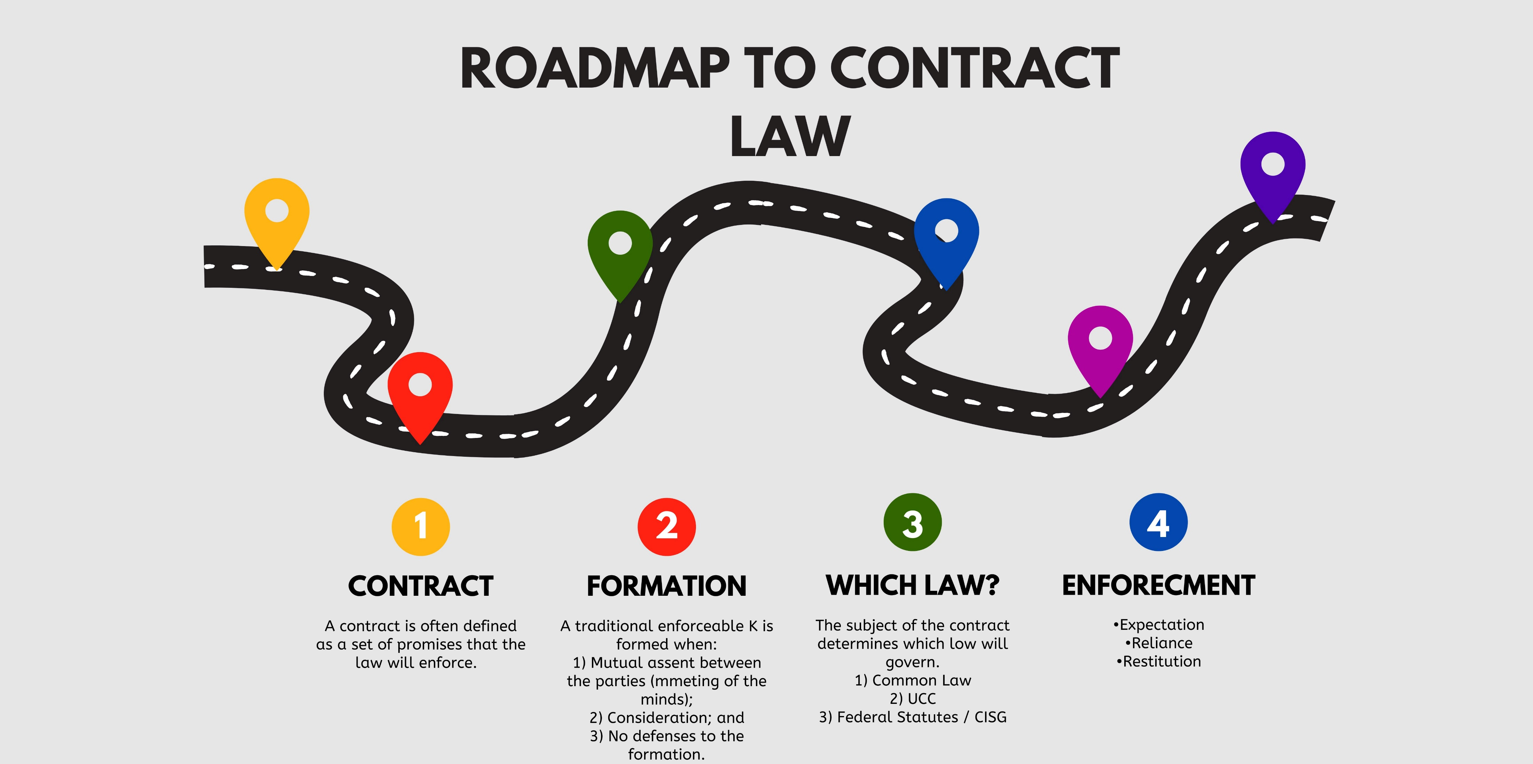

Slide 15
What is a Contract?
What is a Contract?
A promise that is legally enforceable
What is a promise?
Actions that show a commitment has been made
What is an Agreement?
Two people showing terms have been agreed on

Slide 16
What is a Contract?
Restatement 2d, § 1. CONTRACT DEFINED
A contract is a promise or a set of promises for the breach of which the law gives a remedy, or
the performance of which the law in some way recognizes as a duty.
(pg. 15)

Slide 17
Promise
§ 2. PROMISE; PROMISOR; PROMISEE; BENEFICIARY
(1) A promise is a manifestation of intention to act or refrain from acting in a specified way, so
made as to justify a promisee in understanding that a commitment has been made,
[ (2) The person manifesting the intention is the promisor.
(3) The person to whom the manifestation is addressed is the promisee.
(4) Where performance will benefit a person other than the promisee, that person is a beneficiary.]
A Promise may be stated in words either oral or written, or may be inferred wholly or partly from conduct.

Slide 18
Agreement
§ 3. Agreement Defined; bargain defined
An agreement is a manifestation of mutual assent on the part of two or more persons. A bargain is an agreement to exchange promises or to exchange a promise for a performance or to exchange performance.

Slide 19
American Contract Law
The Three Dimensions of Law
Doctrine
The rules and principles of law by which judges justify their decisions. This is what the general public thinks of as “the law”.
Facts
The actual application of the doctrine by courts.
Theory
The rationales or reasons for the legal doctrine. The principal source of theory is the “common sense” of the lawmakers.
“…[these] are implicitly or explicitly informed by other disciplines such as history, economics, or philosophy.” Barnett, p 5

Slide 20
Shaheen v. Knight
Parties
Historical Facts
Procedural Facts
Issue
P’s Claims
D’s Claims
Conclusion / Rule
Court’s Reasoning

